Slide 1
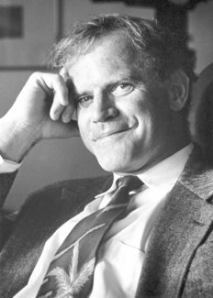
Polymerase Chain Reaction (PCR)

Slide 2
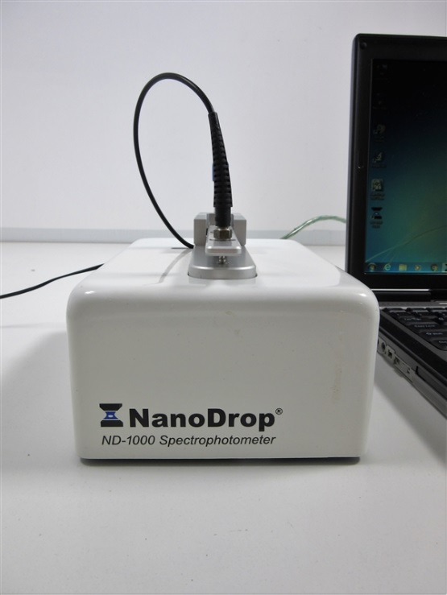
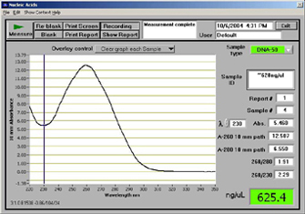
Recap from last week
So, we've extracted DNA from whole anemones, some of which (the unbleached ones) contained symbiont DNA.
Sampled extractions contain DNA and are reasonably clean.
So, now we have a small amount of all of the genomic DNA. But how do we get enough of our regions of interest to study them?
Polymerase chain reaction (PCR) amplifies target regions of genomic DNA.

Slide 3
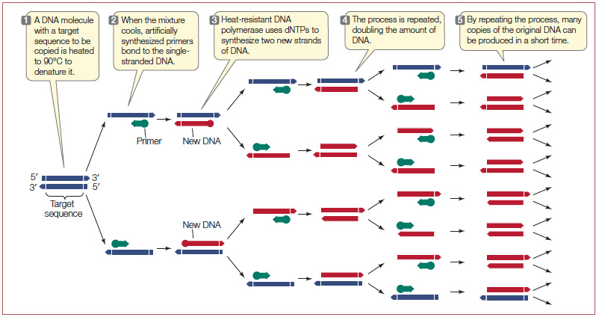

Slide 4
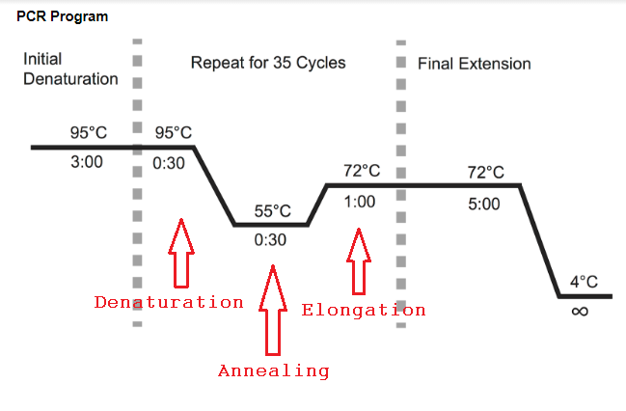
PCR programs and ingredients
PCR ingredients:
Buffer (TRIS, KCl, MgCl2)
necessary for polymerase activity
Taq polymerase enzyme
dNTPs
the monomers of DNA
Template DNA
your samples!

Slide 5
The TRP family: Transient Receptor Potential channels
TRP channels are family of gated ion channels in animals (~30 present, depending on species)
TRP channels gated by a variety of stimuli including temperature and ligands (i.e. molecules) including menthol and capsaicin

Slide 7
Finding TRPA1s
We know TRPA1s are a menthol receptor, and we know that menthol bleaches anemones.
Could TRPA1 signaling affect downstream activities that are involved in bleaching?
How do we find out if our anemones have TRPA1?

Slide 8
Types of homology: orthology and parlogy

Slide 9
pBLAST: protein basic local alignment search tool
Known TRPA1 sequences were BLASTED against the genome of Exaiptasia pallida, yielding hundreds of partial matches.
The best matches were checked for the presence of the menthol binding domain, and primers were designed to assay diversity among our genets across that region of DNA.

Slide 10
Example gene model

Slide 11
Symbiodinium 23S PCR
23S codes for ribosomal RNA
PCR for Symbiodinium chloroplast 23S
23S_F-Forward_Overhang: TCGTCGGCAGCGTCAGATGTGTATAAGAGACAGAATAACGACCTGCATGAAAC
23S_R-Reverse_Overhang:
GTCTCGTGGGCTCGGAGATGTGTATAAGAGACAGGCCTGTTATCCGTAGAGTAGC
Product ~500bp

Slide 12
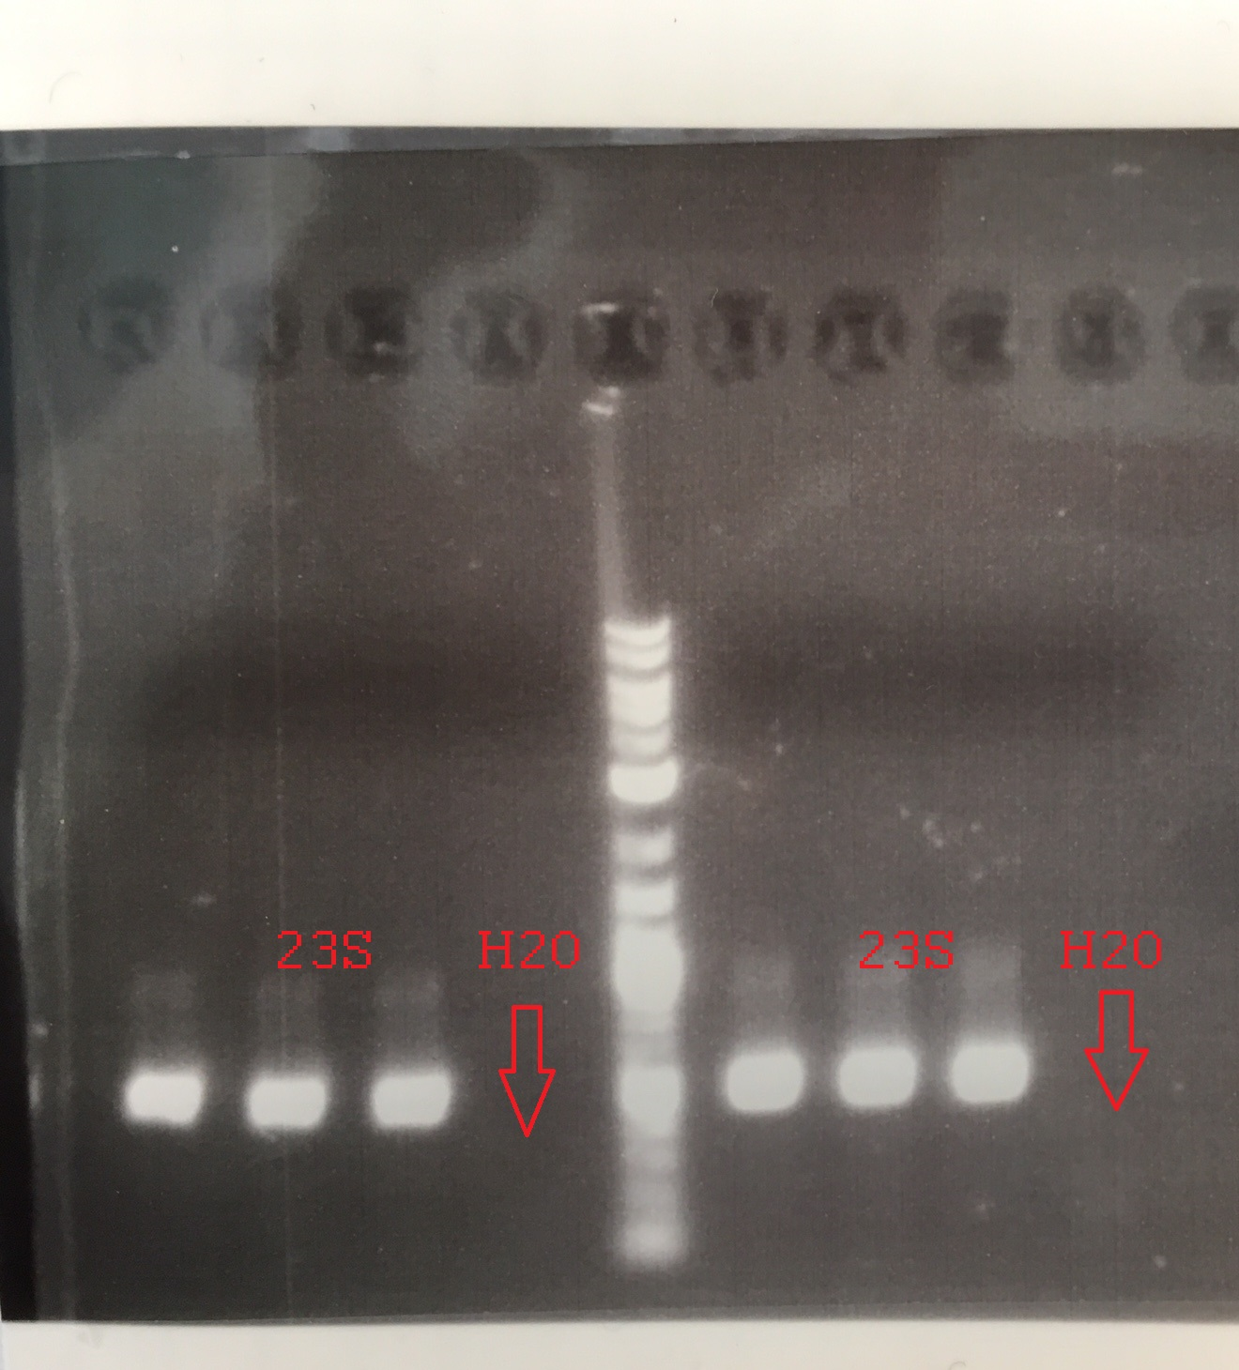

Slide 13
Goals
Amplify the Breviolum 23S and 3 putative Exaiptasia TRPA1 sequences
Confirm the reaction was successful by gel electrophoresis and then sequence the amplicons.
Determine if genetic diversity across these loci corresponds to phenotypic diversity observed in stress tolerance.

Slide 14
Mixes and program
PCR program
1: 94C 1:30
2: 94C 0:30
3: 58C* 0:30
4: 72C 1:30
5: Go to 2 (34x)
6: 72C 5:00
7: 4C forever
*23S annealing is 56C
TRP reaction mix
23ul 2x GoTaq + H2O
(12.5ul GoTaq, 10.5ul H2O, premixed)
1ul appropriate primers
1ul template DNA
23S reaction mix
23ul 2x GoTaq + MgCl2 + H2O (12.5ul GoTaq, 1.5ul 25mM MgCL2, 9ul H2O, premixed)
1ul 23S F/R
1ul template DNA (use control sample for this one)

