Slide 1
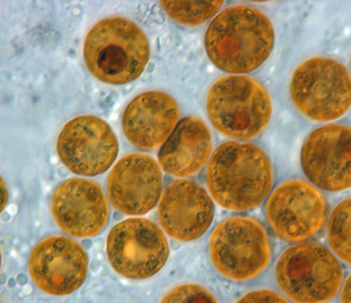
Mutagenesis of Breviolum minutum

Slide 2
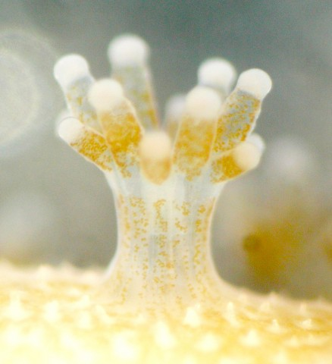
Background
Breviolum minutum is a unicellular algae in the family Symbiodinaceae.
Symbiodinaceae algae are photosynthetic endosymbionts that live inside the cells of cnidarians (corals, anemones and jellyfish) and provide their host with nutrition.
The strain we are using—SSB01—is useful because of it’s ability to grow on cell culture plates.

Slide 3
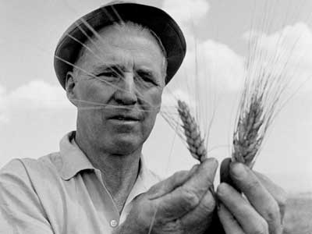
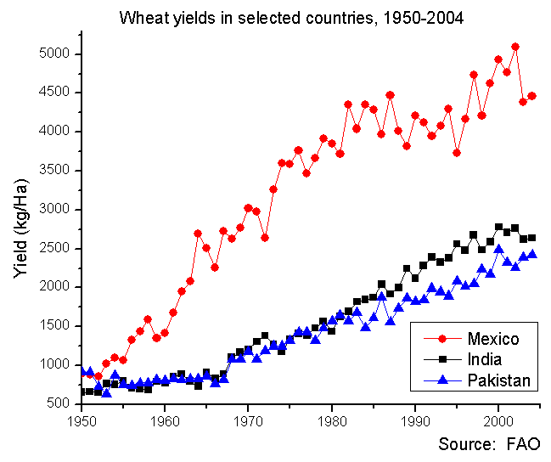
Forward genetics
Forward genetics is when we search for a phenotype that we care about and then determine the responsible genotype.
Norman Borlaug won the Nobel Peace Prize in 1970 for his contributions to increasing the global food supply.
His team worked primarily by making thousands of crosses to increase wheat yields in developing countries.
This work began 10 years before DNA sequencing technology was developed.

Slide 4
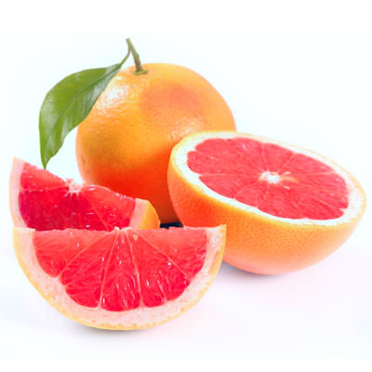
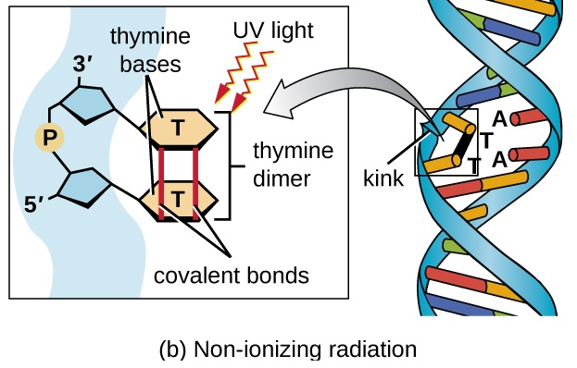
UV mutagenesis
A number of techniques (enzymes, chemicals, and radiation) can be used to create random mutations. This process is called mutagenesis.
The color of this star ruby grapefruit is the result of random mutagenesis.
Ultraviolet mutagenesis works by fusing adjacent thymine molecules, which are then excised in repair, causing a deletion.

Slide 5
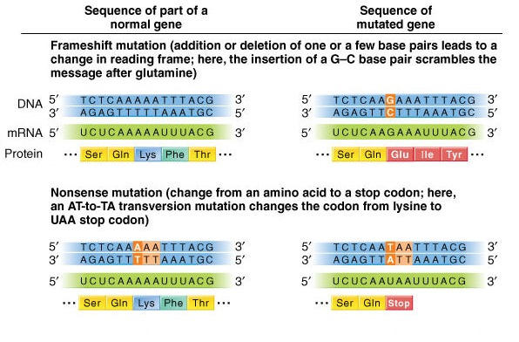
Types of mutations
Mutagenesis can affect gene function (and, therefore, phenotype) by the introduction of frameshift or nonsense mutations (among others).
In a frameshift mutation, the reading frame becomes shifted resulting in codons that spell out an entirely different protein.
In a nonsense mutation, an early stop codon is introduced, resulting in a truncated protein.
Either of these can result in a complete knockout of gene function (null).

Slide 6
Today’s mutagenesis
Today, we will be mutagenizing B. minutum with ultraviolet light.
Because the mutations we will produce are random, we need a way to screen for a phenotype.
A screen allows us to separate individuals carrying mutations that affect them in some way we care about from the rest of the population.
Mutagenesis of B. minutum is rapid, because the cells are haploid.
This means that there is no second copy of the genome to mask or rescue the effects of any mutations.
Next week, we will screen for resistance to 5-FOA, a chemical that is toxic to wildtype Breviolum.
But what other sort of phenotypes could we find if we used another type of screen?

Slide 7
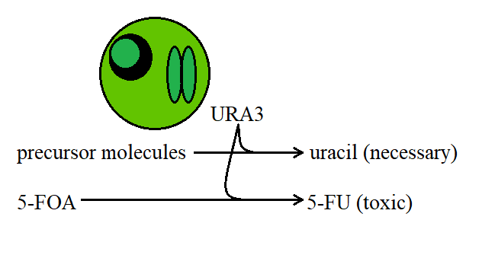
URA3 and 5-FOA resistance
URA3 is a gene that is necessary for uracil production.
Remember, uracil is a building block of RNA.
The URA3 protein also converts 5-fluoroorotic acid (5-FOA)—a harmless compound—to the toxic 5-fluorouracil (5-FU).

Slide 8
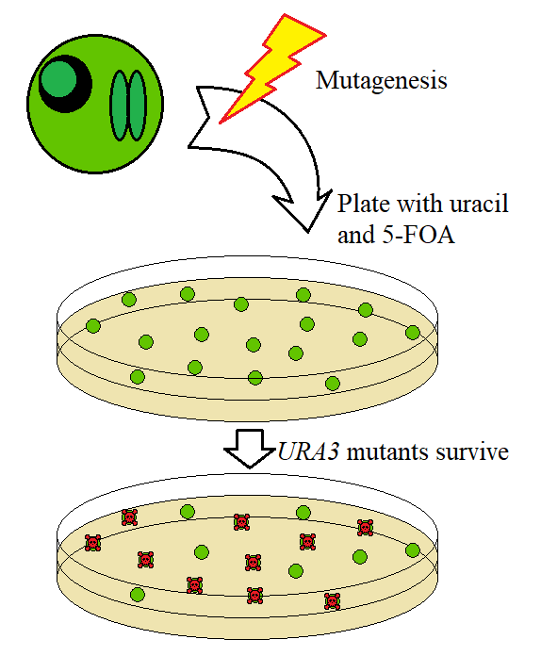
Screening for 5-FOA resistance
Next week, we will spread our cells on culture plates containing uracil and 5-FOA.
The uracil will keep URA3 mutants alive and the 5-FOA will kill cells with wildtype 5-FOA.
Based on the number of colonies that grow on our plates, we can determine how many URA3 knockouts we generated!

