Slide 1
Genetics Lab
Spring 2019

Slide 2
Purpose of this lab:
Our goals in this lab are to understand the genetic basis of coral bleaching—or the genetic basis of tolerance to bleaching stresses.
Along the way, we hope to teach you the basic principles of genetics and real laboratory skills that will prepare you for work in a laboratory if you choose to pursue that path!

Slide 3
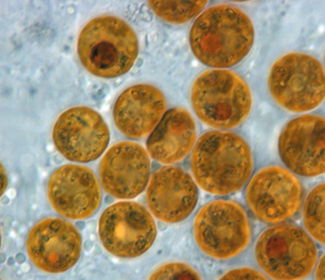
What are corals?
Corals are animals in the phylum Cnidaria, and they form the trophic and structural basis for coral reef ecosystems.
Coral reefs are the most diverse ecosystems in the ocean!
Corals obtain most of their nutrients from symbiotic algae (family Symbiodinaceae) that photosynthesize and live inside their cells in exchange for protection and nutrients.

Slide 4
Coral life cycle
Individual coral animals (polyps) reproduce asexually to create clonal colonies.
Coral also reproduces sexually, with each polyp spawning gametes which fertilize in the open water and develop into larvae.
These free swimming larvae are colonized by Symbiodinaceae algae before settling and developing into adults to repeat this cycle.

Slide 5
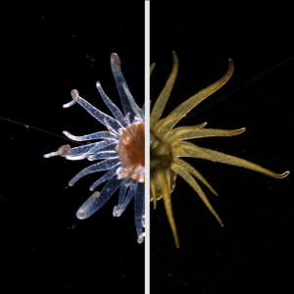
What is coral bleaching?
Coral bleaching is the process by which heat, UV and/or chemical stressors induce the loss of photosynthetic algae in coral tissues.
The color of healthy wild corals comes primarily from the algae, and this loss of algal pigment is why the animals are referred to as “bleached.”
Rising ocean temperatures have resulted in an increase in the number and intensity of bleaching events worldwide.

Slide 6
“According to the United Nations Environment Programme, between 2014 and 2016 the longest recorded global bleaching events killed coral on an unprecedented scale. In 2016, bleaching of coral on the Great Barrier Reef killed between 29 and 50 percent of the reef's coral. In 2017, the bleaching extended into the central region of the reef. The average interval between bleaching events has halved between 1980 and 2016.” –from Wikipedia

Slide 7
But back to our purpose: how to we understand the genetic basis of coral bleaching?

Slide 8
Experiment one: the anemone stress challenge
We will work with the symbiotic sea anemone Exaiptasia pallida as a model for understanding corals.
Exaiptasia engages in symbiosis with the same algae, can be bleached (and survive!) and grows much more quickly and is more easily cared for under laboratory conditions.

Slide 9
Anemone stress challenge (continued)
Each individual anemone can be cut and will recover to form a new individual.
In this way we have created familes (genets) of genetically identical individuals (ramets).
We can then expose each ramet to a different stress regimen and see how it compares to the control treatment from the same genet.

Slide 10
Which genet displays a “tolerant” phenotype to heat stress?
Since each anemone is genetically identical to the other anemones in its genet, we can assume that only differences in treatment are responsible for differences we observe between anemones in a genet.
If one genet appears to tolerate high temperature and another does not, maybe the difference in tolerance is genetically based!

Slide 11
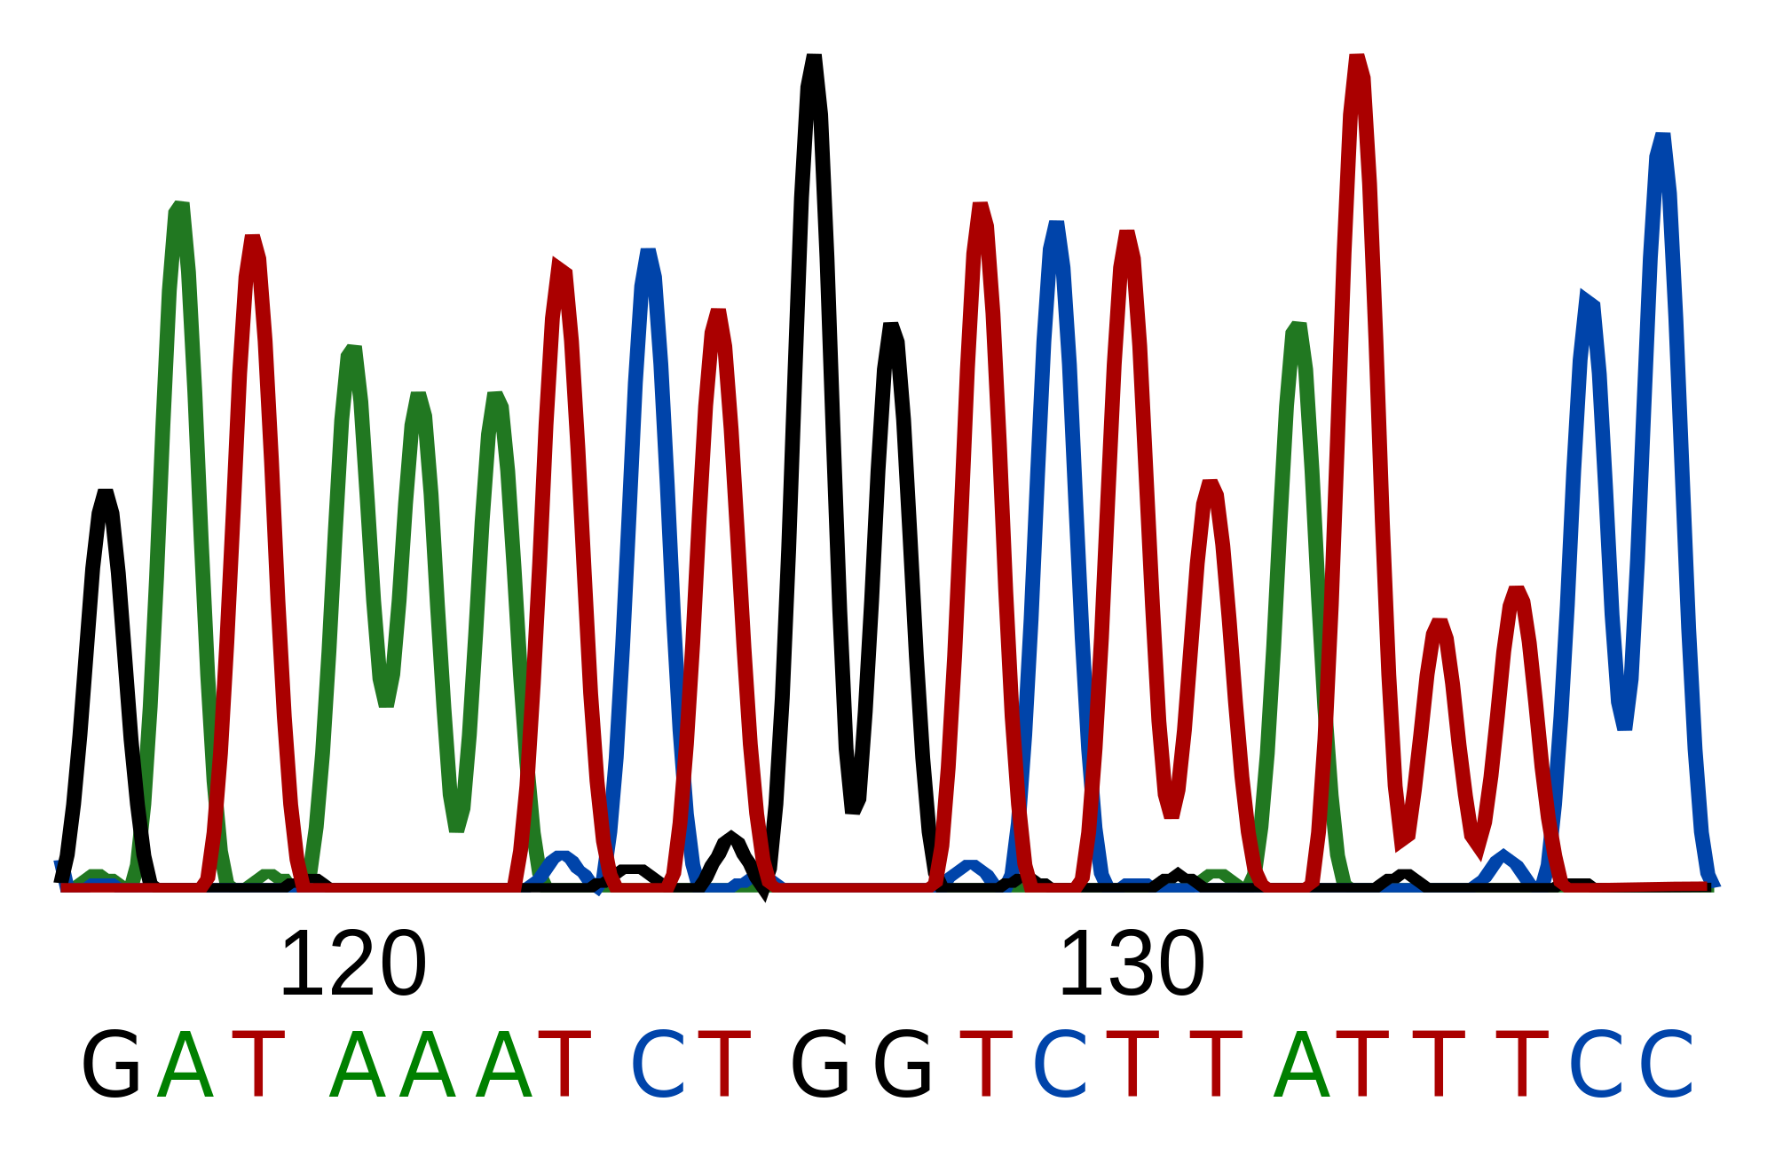
Determining anemone genotypes
Over the course of this semester, we will:
extract DNA from your anemones
amplify genes of interest from your anemones and algae
sequence those genes
Practice molecular systematics to understand how those sequences are related to each other
The big question: do the results of your gene phylogenies correlate to thermal tolerance?

Slide 12
Experiment two: mutagenesis of Symbiodinaceae
Forward genetics: find a phenotype, then figure out the genotype of that mutant
A classic example is a mutagenesis screen, where random mutations are induced and we search for an individual with certain properties
Reverse genetics: engineer a mutation in a gene of interest, then see if that mutation causes a phenotype
We will conduct a mutagenesis screen my exposing Symbiodinaceae to UV and looking for mutants that can survive on cell-culture plates supplemented with 5-FOA.
5-FOA is broken down into 5-FU, which is lethal to wildtype algae.

Slide 13
What to expect from this course:
Please always show up with a lab notebook, pen/pencil, and—when necessary—a computer.
Open-toed shoes and food/drink are strictly prohibited.
Always check the course website (fiugeneticslab.fiu.edu) for assignments and updates to the schedule
Grades will be broken down as follows:
20% attendance
20% participation
20% lab notebook
Will be collected twice this semester
Do not focus on hypotheses/writing each lab up like an experiment; note that there are really only two experiments in this whole semester, and instead focus on explaining the methods of each lab and how they work in service to the overall goal of the experiments.
20% presentation
20% final exam

Slide 14
For today:
Observe symbiotic and aposymbiotic (i.e., without algae) anemones under the microscope. Draw a picture of what you see and note the differences in color. What accounts for this difference?
For next lab: please print out, sign and turn in the last page of the syllabus document from the website.

